Slide 1
Developing Integration Solutions using Microsoft BizTalk Server 2013
Business Activity Monitoring

Slide 2

Course Outline
Module 1: Introduction to BizTalk Server
Module 2: Schemas
Module 3: Maps
Module 4: Testing and Deploying BizTalk projects
Module 5: Pipelines
Module 6: Routing
Module 7: Adapters
Module 8: Web Services and WCF
Module 9: Introduction to Orchestrations
Module 10: Applied Orchestration Techniques
Module 11: Business Activity Monitoring
Lesson 1: Business Introduction to Business Activity Monitoring
Lesson 2: Utilizing Business Activity Monitoring
Module 12: Integrating Business Rules
Module 13: Deploying and Managing Applications
Module 14: Windows Azure BizTalk Services

Slide 3
Lesson 1: INTRODuction to Business Activity Monitoring
Monitoring your processes
What is Business Activity Monitoring?
BAM Components

Slide 4

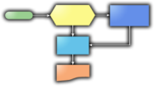
Monitoring your processes
What is the average processing duration for orders?
What is the order trend for product XYZ over the past 24 hours?
How many orders processed were over $1,000?
BAM
Primary Import
Received
Approved
Declined

Slide 5
DTA Tracking
DTA database is optimized for insert, not for select. Filtering a none indexed column can take time.
DTA Tracking is only visible through BizTalk Administration Console
DTA Tracking can only track promoted properties
Tracking promoted properties consumes resources
You can only query one partition of DTA Tracking
No support for aggregations

Slide 6
What is Business Activity Monitoring?
Business Activity Monitoring (BAM) allows us to track information of interest related to a business process to a separate (database) storage.
BAM enables users to search and filter that information.
Through Analysis Services, BAM enables users to aggregate business related data into relational cubes.
The BAM Portal provides functionality to define charts, reports, KPI’s and alerts.

Slide 7
Tools and Services
BAM Portal
Microsoft Office Excel
Custom user interface
Presentation
Microsoft Office Excel
BAM Manager
(Console)
Tracking Profile Editor
Tools
BAM Management Web Service
BAM Event Bus Service
SQL Notification Services
Services

Slide 8
BAM vocabulary
Activity => Database table(s)
Activity Item => Table column
Milestone => DateTime datatype
Tracking Profile => Mappning between Activity and payload data schema

Slide 9
Lesson 2: utilizing business activity monitoring
Create Activities
Demonstration: Create Activities using Excel
Deploy Activities
Demonstration: Deploy Activities using BM.EXE
Map activity items to data
Demonstration: Map activity items to data using Tracking Profile Editor
Analyze the data
Demonstration: Using the BAM Portal

Slide 10



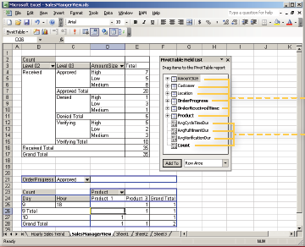




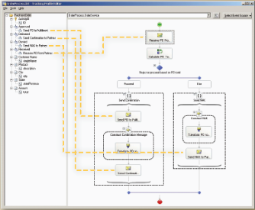

The Scenario
1
Identify KPIs
2
”The Business Analyst”
System Administrator
Deploy
4
View
3
Connect
BAM
”Information Worker”
Developer

Slide 11

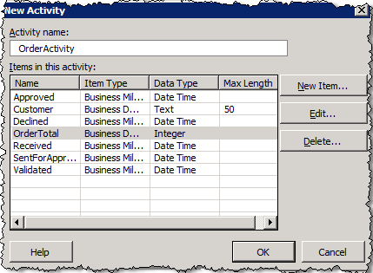
”The Business Analyst” – Creates Activity
Events and data to be tracked (Activities)
Milestones
Data points
Groupings and aggregations (Views)
Durations
Dimensions
Measures
ActivityID | LastModified | Received | Approved | Declined | OrderTotal | Customer

Slide 12

Demo
Create Activities and Views
Notes:
(Slide 12)
Open Excel
Enable the BAM AddIn in Excel by going to Office button – Excel Options – AddIns – Excel Addins [Go] – and select Business Activity Monitoring.
Create the following OrderActivity Activity items:
ReceivedOrder – Milestone
Customer – Data
OrderTotal – Integer
SentForApproval – Milestone
ApprovalResponse – Milestone
Approved – Milestone
Declined – Milestone
Create the OrderView view
Add all activity items
Add a new Group – Finished – include Approved and Declined. Second.
Add a new Duration - ProcessDuration – between Received and Finished. Second.
Add a new Duration – ApprovalDuration – between SendForApproval and ApprovalResponse.
Create the CustomerDimension (Data Dimension) using Customer.
Create the OrderTotalMeasure (Measure) using OrderTotal.
Create the ReceivedDimension (Time Dimension) using ReceiveOrder, down to the minute.
Finish the process.
Drag Customer Dimension to the area on the left.
Drag Received Dimension to the top area.
Drag OrderTotalMeasure to the middle area.
Save the workbook.

Slide 13
System Administrator – Deploys Activities and Views
C:\> BM deploy-all -DefinitionFile:SalesManagerView.xls
Or
C:\> BM deploy-all -DefinitionFile:SalesManagerView.xml

Slide 14
Demo
Deploy Activities and Views
Notes:
Show and talk about options for bm.exe
bm deploy-all –definitionFile:”filehere.xlsx”
Get exception, explain known error: Using a non English (US) locale with a English install of BizTalk Server. Solution: Switch to enlish locale.
Show creation of Live workbook
Show database infrastructure once deployed (tables, views)
Select from active and completed tables

Slide 15
Deploy-all
Tables
[ActivityName]_Active
[ActivityName]_ActiveRelationships
[ActivityName]_Completed
[ActivityName]_CompletedRelationships
[ActivityName]_Continuations
Views
[ActivityName]_ActiveInstances
[ActivityName]_AllInstances
[ActivityName]_AllRelationships
[ViewName]_*
SSIS Packages
BAM_DM_[ActivityName] – Purge & Archive
BAM_AN_[View] – Update cubes
Analysis Server
BAMAnalysis
Cubes
Notes:
Talk about purge jobs

Slide 16
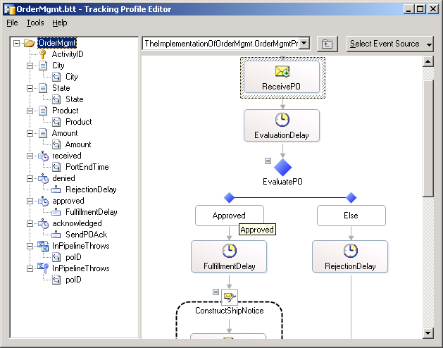
Developer – Maps Activity Items to real data
Use Tracking Profile Editor to link
Schema elements to Activity Items

Slide 17
Demo
Maps Activity Items to real data using the Tracking Profile Editor (TPE)
Notes:
(Slide 17)
Show some of the options of the tool
Map to Mod11 orchestration.
Apply Tracking Profile
Run messages through the flow, some approved, some not
Select data from the tables

Slide 18
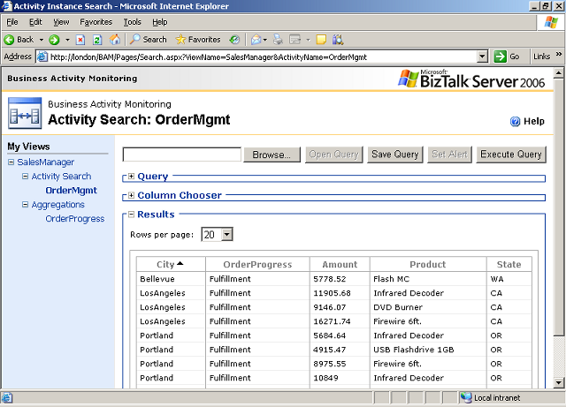
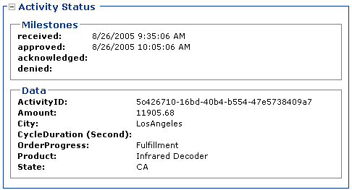
Analyze the data
Analyze the data using:
BAM Portal
MS Excel
Reporting services
Custom tool

Slide 19
Demo
Analyze the data
Notes:
(Slide 19)
Run SSIS Package BAM_DM_OrderActivity (run data maintenance)
Run SSIS Package BAM_AN_OrderView (populate cubes)
View impact on tables
View the view bam_OrderActivity_AllInstances
Use BAM Portal and Excel spreadsheet
View the view bam_OrderView_ViewOrderActivity_View

Slide 20
Summary
Use BAM to capture business (or infrastructure) data and allow it to be searchable in a scalable and maintenance proofed data layer.
Use excel to define Activities and Views.
Use bm.exe to deploy and manage BAM tables and views.
Use TPE to connect activities to data sources.
Use the BAM Portal (and other tools) to view tracked data.
Use SQL Server Agent jobs to provide data pruning and maintenance.

Slide 21
Q & A
Business Activity Monitoring

Slide 22


Hands-On-Labs
Enabling Business Activity Monitoring
Define a BAM observation model
Deploy BAM observation model
Map BAM observation model to implementation
View KPI’s and create alerts

Slide 23

Quiz
What does the BM.exe command line tool do?
What are the tasks performed by SQL Server Agent to BAM data?
What are examples of tools you can use to view tracked data?

